Slide 1
CHARITY DONORS PREDICTION
Ramgopal Tummala,180030385, Batach-170
Under guidance of V.Bhanvani

Slide 2
Introduction System Requirements Software used Data engineering Analytics Conclusion

Slide 3
System Requirements
Windows 10 or later
Ram – 4gb or higher

Slide 4
Software Requirements
Jupyter Notebook
Sqoop
Hadoop
Data Base – Mysql

Slide 5
Language Used
Mysql
Python
Mysql is database language which is used for operating data base
Alternative : Oracle, Mango Db
Python is covered around 85% in this whole project. Many inbuild libraries helps in reducing of code.
Alternative : R

Slide 6
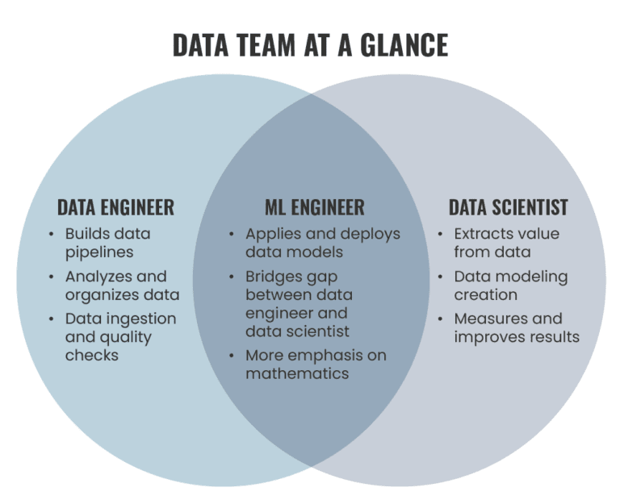
Data Engineering
Data engineering is the practice designing and building systems for collecting, storing, and analyzing data at scale. It is a broad field with applications in just about every industry. Organizations have the ability to collect massive amounts of data, and they need the right people and technology to ensure the data is in a highly usable state by the time it reaches the data scientists and analysts.

Slide 7
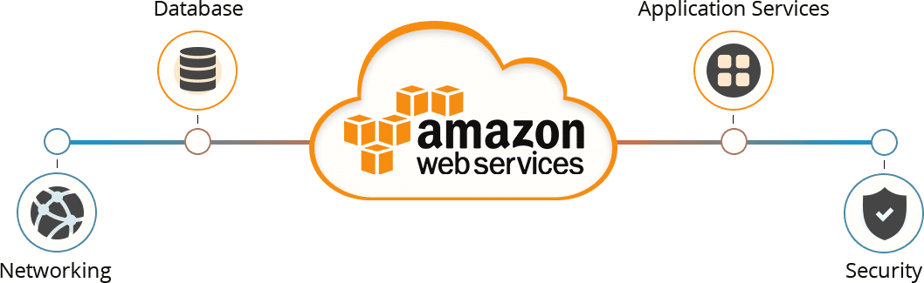
Cloud Service
EMR (Elastic Map Reduce)— This AWS analytics service mainly used for big data processing like Spark, Splunk, Hadoop, etc.
Data Pipeline— Allows you to move data from one place to another. For example from DynamoDB to S3.

Slide 8

HDFS
The Hadoop Distributed File System (HDFS) is the primary data storage system used by Hadoop applications. HDFS employs a NameNode and DataNode architecture to implement a distributed file system that provides high-performance access to data across highly scalable Hadoop clusters.

Slide 9
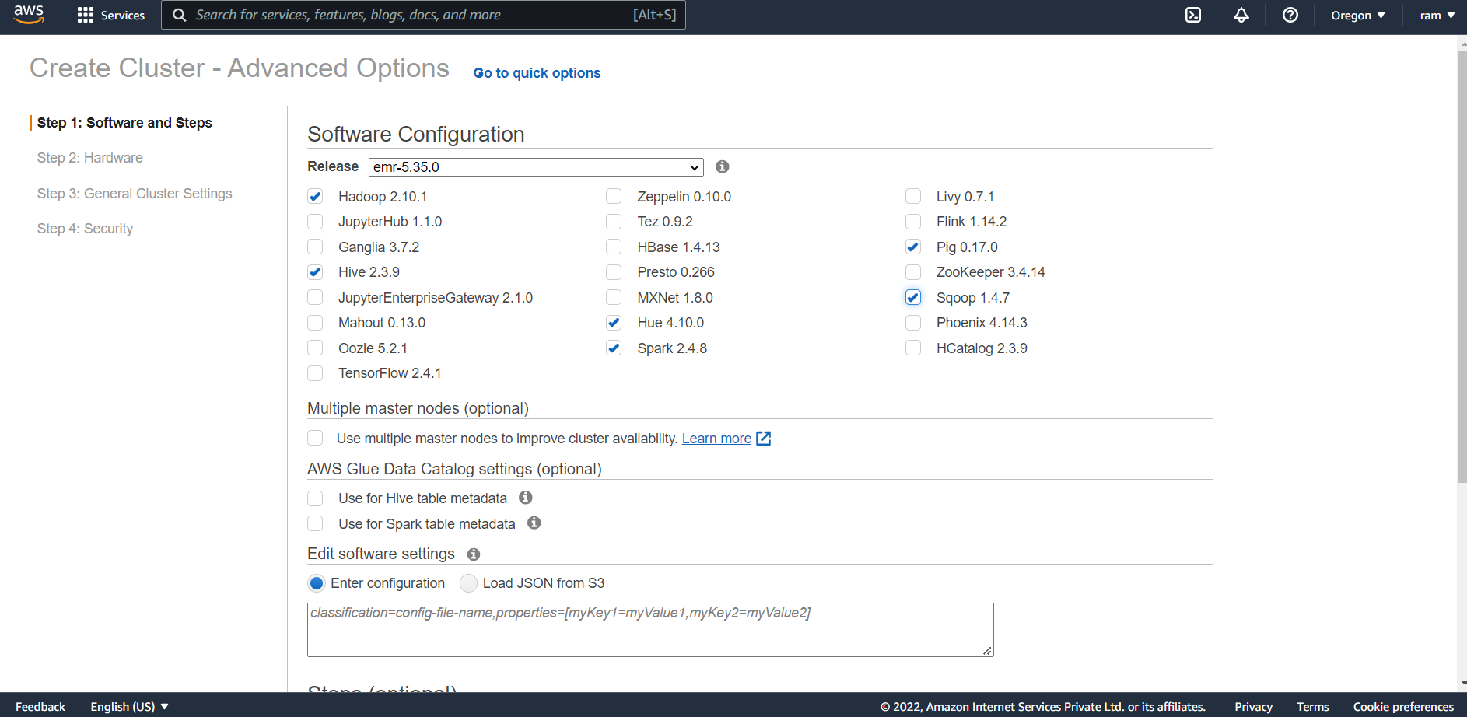
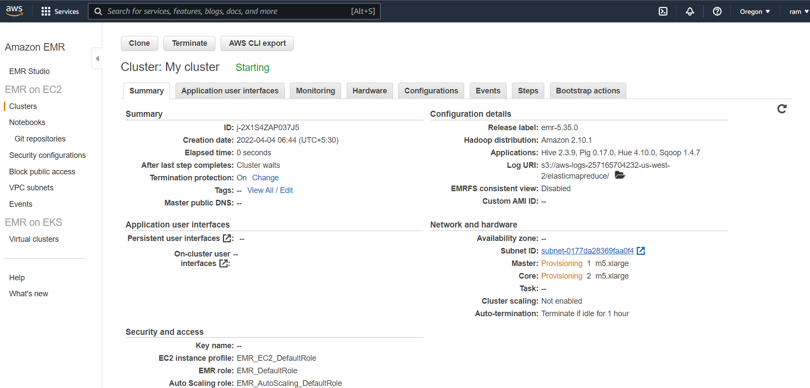
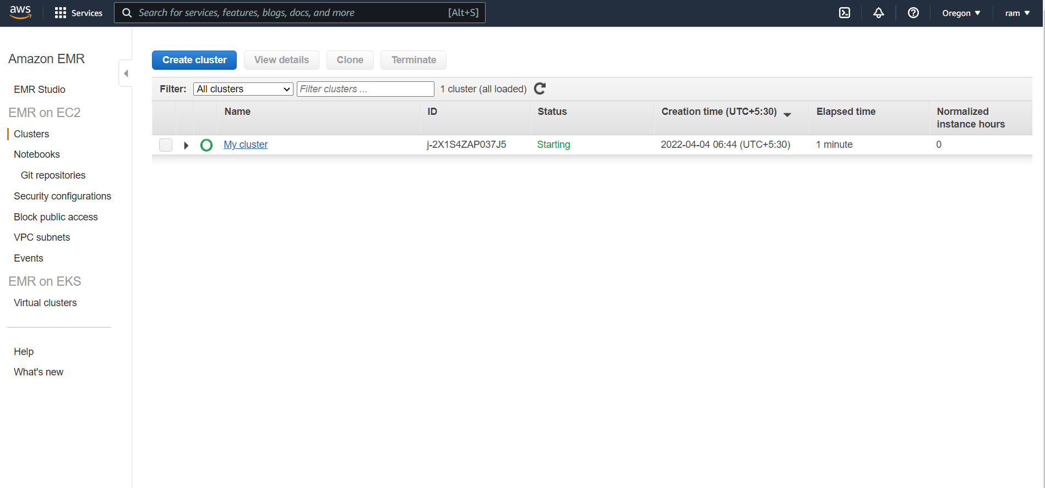

Slide 10
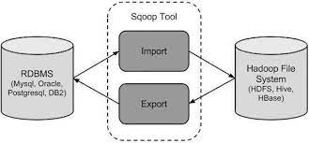
Sqoop
Apache's Sqoop is designed to bulk-load data from relational databases to the Hadoop Distributed File System (HDFS). For this tip we will examine a Sqoop Linux command that will access a table. We will complete this tip with an example using the AdventureWorksDW2014 database. This tip is written using SQL Server 2014 and a Cloudera virtual machine.

Slide 11
Sqoop Import
sqoop import --connect jdbc:mysql://db.foo.com:3306/bar \
--table EMPLOYEES \
--username <username> \
--password-file ${user.home}/.password
sqoop export \
--connect jdbc:mysql://localhost/db \
--username root \
--table employee \
--export-dir /emp/emp_data

Slide 12
Business problem
There is one charity called charity which feeds homeless people, for donations this charity sends postal mails to residents of Delhi requesting to donate for a cause, from the historical data it is evident that residents who earn more than 50 thousand dollars per annum are more likely to donate. But the charity cannot be able to figure out how to send postal mails to those who most likely to donate to charity and avoid sending postal mails to those who are most likely are not going to donate to charity so that charity can save much money

Slide 13
Data Set
the Database consists of 14 columns that describe the resident of Delhi, and consists of 45222 instances. I will split the data into training, and testing data use them to build a robust model for prediction. The dataset I found is from the below link
Age, workclass , education, marital-status, occupation, relationship, race , sex, capital-gain, capital-loss, hours-per-week, native-country:

Slide 14
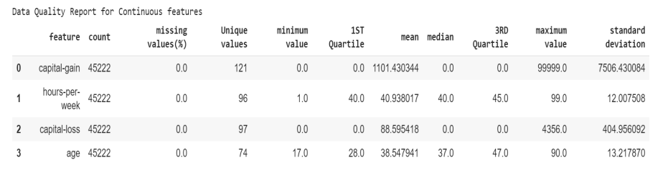
Data Quality Report
The dataset contains continuous and categorical features I have divided features into two sets as continuous and categorical based on the datatype of the feature Data Quality report table for Continuous features

Slide 15
Models Used
DecisionTreeClassifier(Information based learning)
KNeighborsClassifier(Similarity-Based Learning )
Naive Bayes(Probability-Based Learning)
Logistic regression(Error Based Learning)

Slide 16
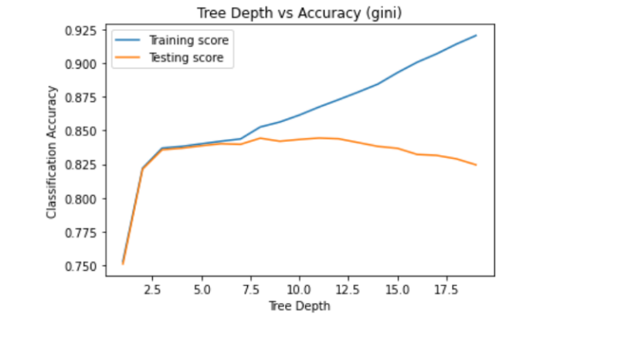
DecisionTreeClassifier
Decision Tree is a Supervised learning technique that can be used for both classification and Regression problems, but mostly it is preferred for solving Classification problems. It is a tree-structured classifier, where internal nodes represent the features of a dataset, branches represent the decision rules and each leaf node represents the outcome.

Slide 17
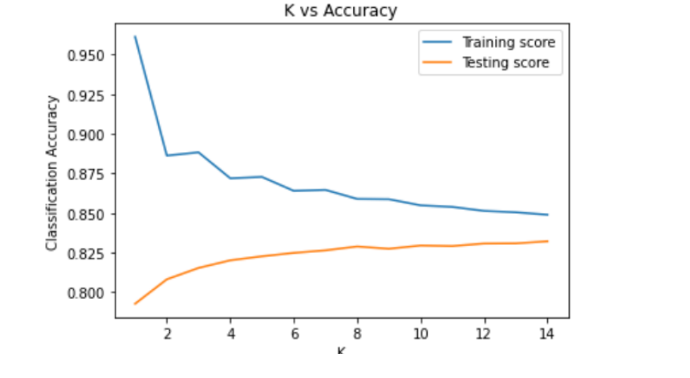
KNeighborsClassifier
The K in the name of this classifier represents the k nearest neighbors, where k is an integer value specified by the user. Hence as the name suggests, this classifier implements learning based on the k nearest neighbors. The choice of the value of k is dependent on data

Slide 18
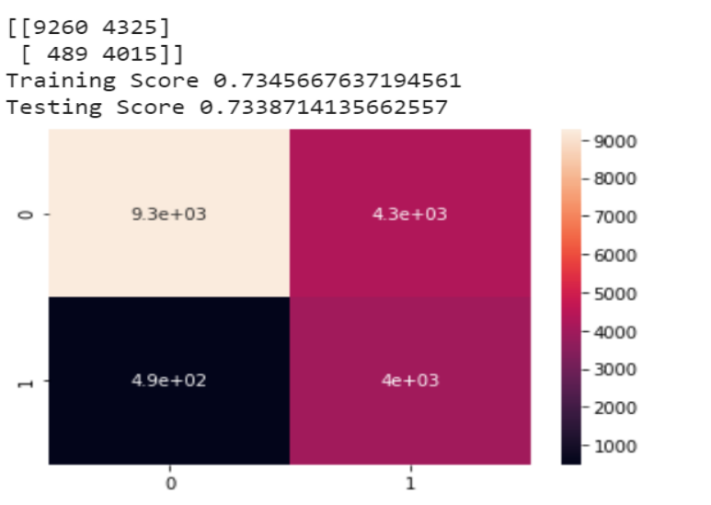
Naive Bayes
Naive Bayes classifiers are a collection of classification algorithms based on Bayes’ Theorem. It is not a single algorithm but a family of algorithms where all of them share a common principle, i.e. every pair of features being classified is independent of each other.

Slide 19
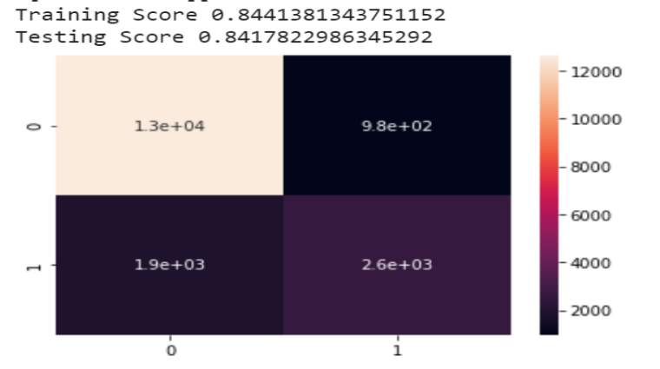
Logistic Regression
Logistic Regression is a classification algorithm. It is used to predict a binary outcome (1 / 0, Yes / No, True / False) given a set of independent variables. To represent binary/categorical outcome, we use dummy variables

Slide 20
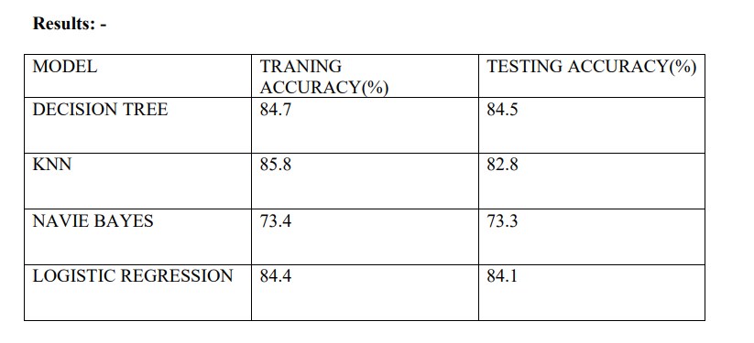
Results and Conclusion
Conclusion:- The best suitable model for the prediction problem is the decision tree model with tree depth = 7
Logistic Regression is the next suitable solution for the prediction with 84.1 percent accuracy .

Slide 21
Future

